Slide 1
CLUSTERING
David Tadeo Andrade
Alejandro Martínez Hernández

Slide 2
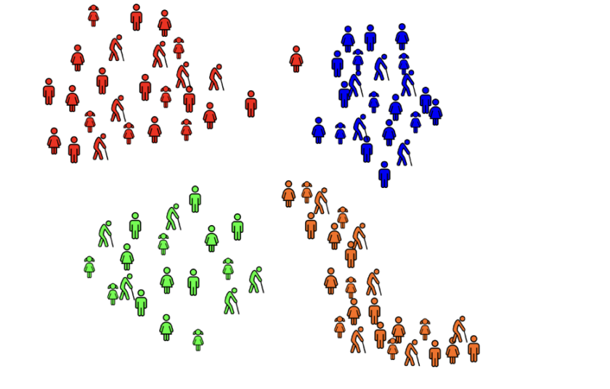
Clustering
"Clustering is the process of grouping a set of physical or abstract objects into classes of similar objects."
— Jiawei Han, Micheline Kamber, and Jian Pei, Data Mining: Concepts and Techniques (Morgan Kaufmann, 2011)
You do not know the categories. There are no predefined labels.
Notes:
Clustering is the process of sorting similar items into groups

Slide 3
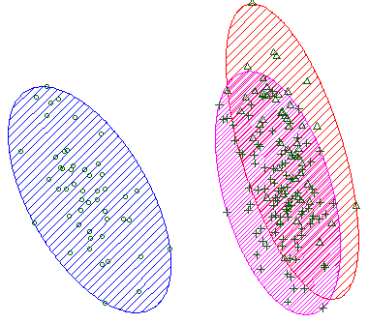
Clustering Methods
Algorithm | Hyperparameter
K-Means Clustering | Partitions data into K clusters by minimizing variance within each cluster.
Hierarchical Clustering | Builds a hierarchy of clusters by iteratively merging or splitting existing groups.
DBSCAN | Forms clusters based on density; groups densely packed points and marks outliers.
K-Means Clustering
Notes:
Unknown sample (Lane 6) indeed shows a visible reduction in the top band (HuR) compared to the equivalent 10μg control (Lane 5).

Slide 4
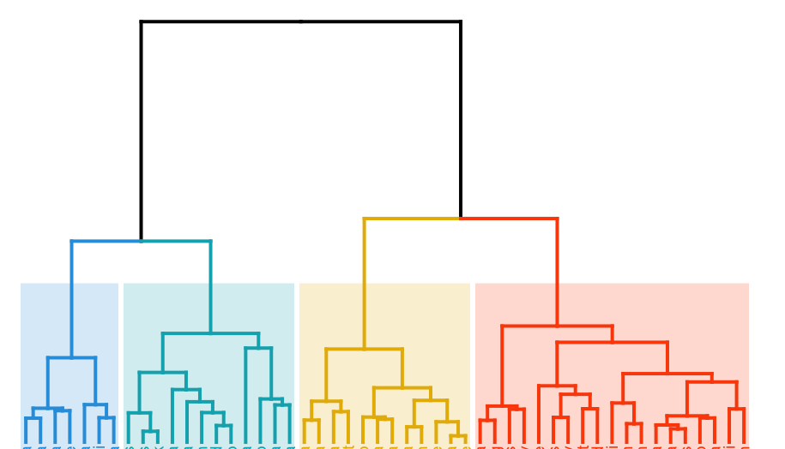
Clustering Methods
Algorithm | Hyperparameter
K-Means Clustering | Partitions data into K clusters by minimizing variance within each cluster.
Hierarchical Clustering | Builds a hierarchy of clusters by iteratively merging or splitting existing groups.
DBSCAN | Forms clusters based on density; groups densely packed points and marks outliers.
Hierarchical Clustering
Notes:
Unknown sample (Lane 6) indeed shows a visible reduction in the top band (HuR) compared to the equivalent 10μg control (Lane 5).

Slide 5
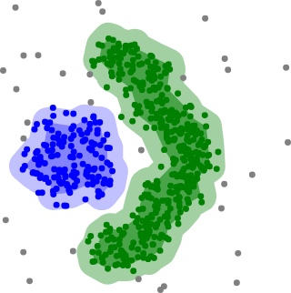
Clustering Methods
Algorithm | Hyperparameter
K-Means Clustering | Partitions data into K clusters by minimizing variance within each cluster.
Hierarchical Clustering | Builds a hierarchy of clusters by iteratively merging or splitting existing groups.
DBSCAN | Forms clusters based on density; groups densely packed points and marks outliers.
DBSCAN
Notes:
Unknown sample (Lane 6) indeed shows a visible reduction in the top band (HuR) compared to the equivalent 10μg control (Lane 5).

Slide 6
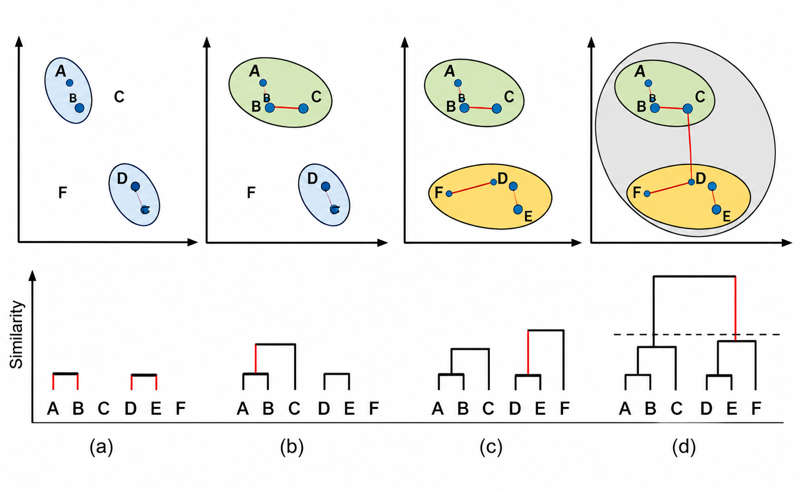
Hierarchical clustering
Bioinformatics Crash Course. (2020).
Look for closest items
Create new branch
Repeat
Notes:
The algorithm constantly looks for the two closest items (whether they are individual points or already-formed groups) and merges them together into a new branch, repeating this until everything is connected."

Slide 7

Hierarchical clustering
Bioinformatics Crash Course. (2020).
Look for closest items
Create new branch
Repeat
Notes:
The algorithm constantly looks for the two closest items (whether they are individual points or already-formed groups) and merges them together into a new branch, repeating this until everything is connected."

Slide 8
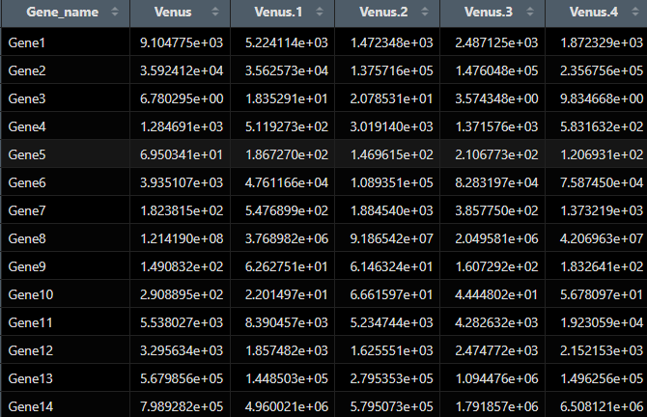
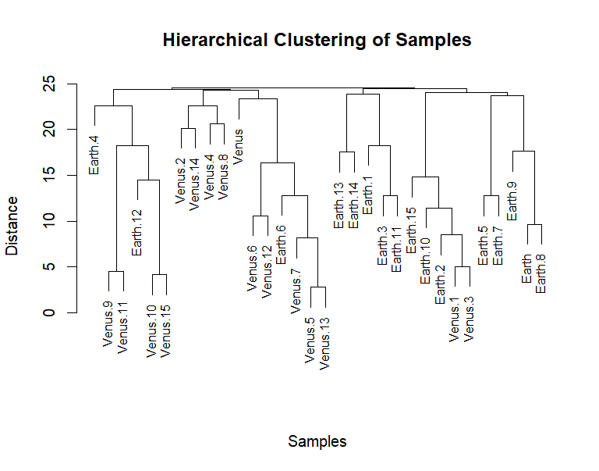
Hierarchical clustering
DATA_SET_REFERENCE_4_A.csv
Notes:
Since we hid the labels (Earth vs. Venus) from the algorithm, it only grouped samples based on raw gene expression. Because the planets are mixed across the branches, it proves that the planet of origin is not the main biological factor driving the differences in these samples. This tells the researcher they need to look for a different hidden variable. Perhaps half of these samples (across both planets) were exposed to a specific disease or a temperature change, and that is what the clustering algorithm is actually picking up on!

Slide 9
Hierarchical clustering
It only grouped samples based on raw gene expression.
The planet of origin is not the main biological factor driving the differences in these samples
Notes:
Since we hid the labels (Earth vs. Venus) from the algorithm, it only grouped samples based on raw gene expression. Because the planets are mixed across the branches, it proves that the planet of origin is not the main biological factor driving the differences in these samples. This tells the researcher they need to look for a different hidden variable. Perhaps half of these samples (across both planets) were exposed to a specific disease or a temperature change, and that is what the clustering algorithm is actually picking up on!

Slide 10
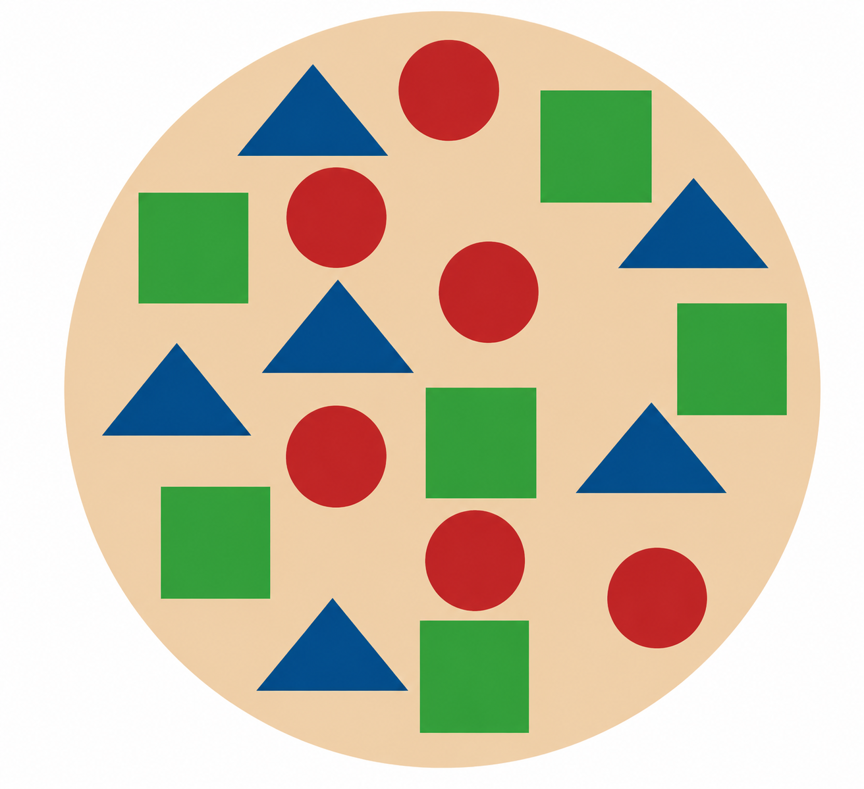
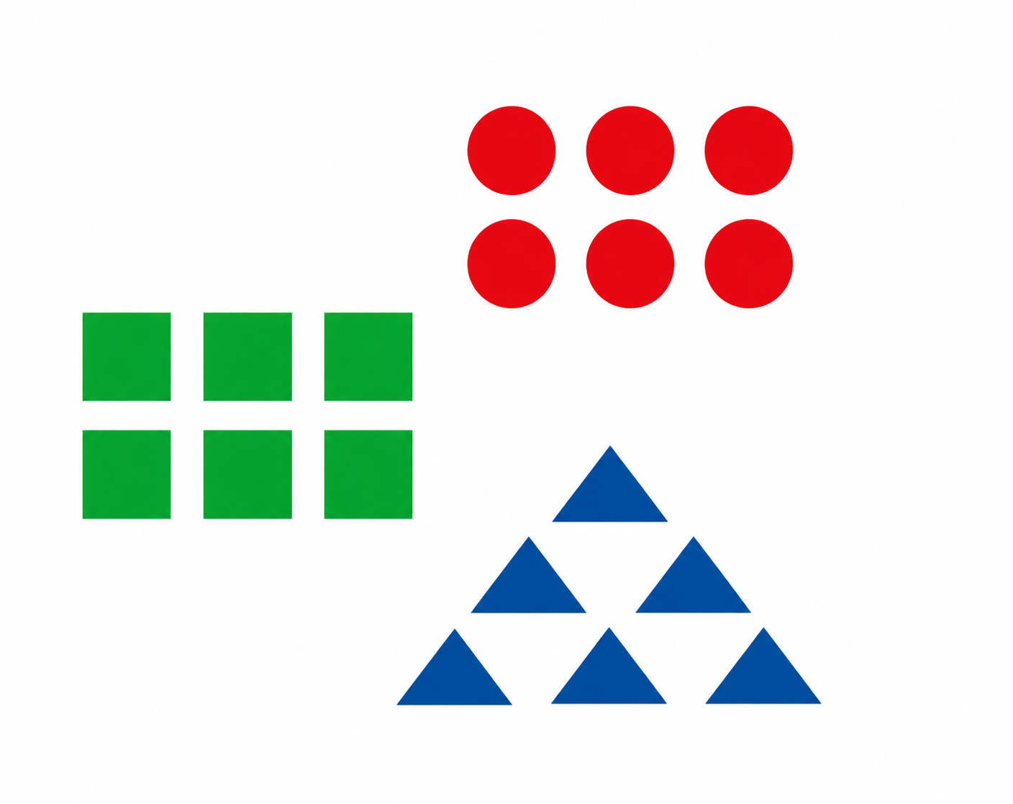
K-means
K-Means Clustering groups similar data points into clusters without needing labeled data.
Identifies grouping of unlabeled data
Group points based on distance to cluster centers
Useful when you need structure from raw, unorganized data

Slide 11
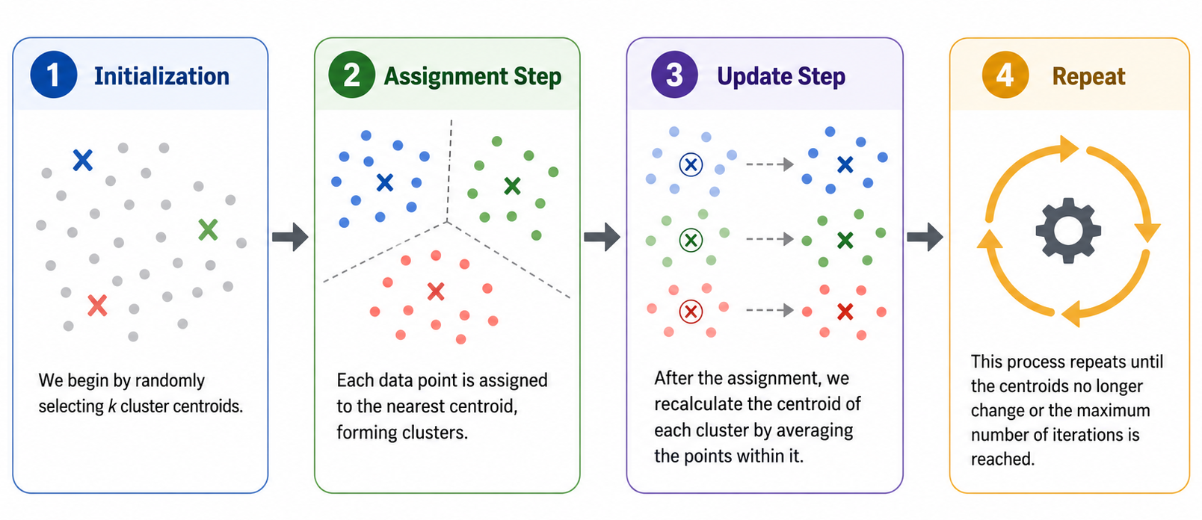
K-means
Algorithm

Slide 12
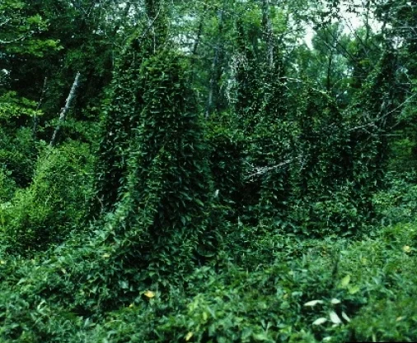
DBSCAN ((Density-Based Spatial Clustering of Applications with Noise)
DBSCAN groups by density.

Slide 13
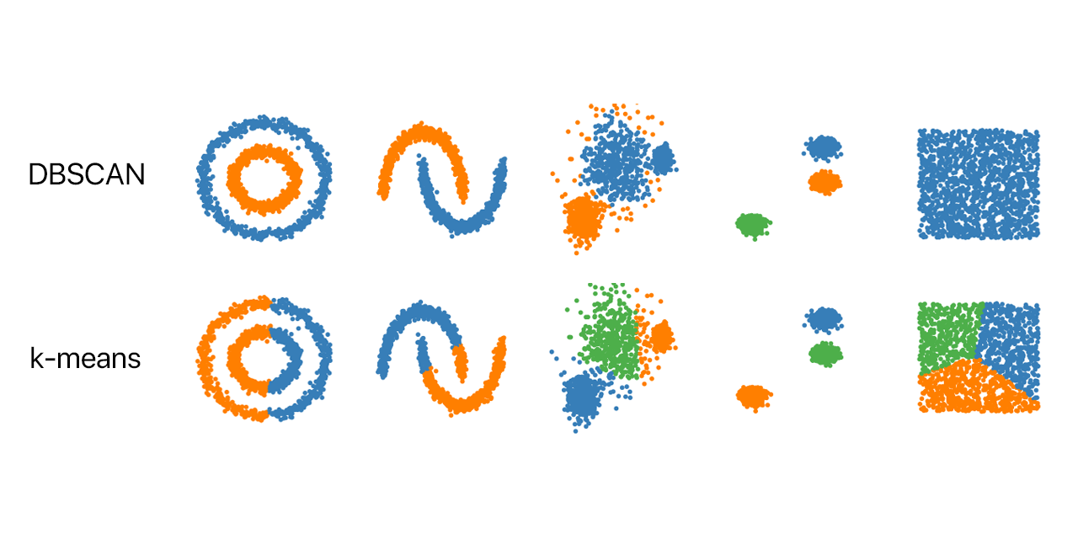
DBSCAN
Groups of strange shapes
figures out the number
Shows outliers
You decide ahead of time exactly how many K
Forces everyone to join a group
Forces everyone to join a group

Slide 14
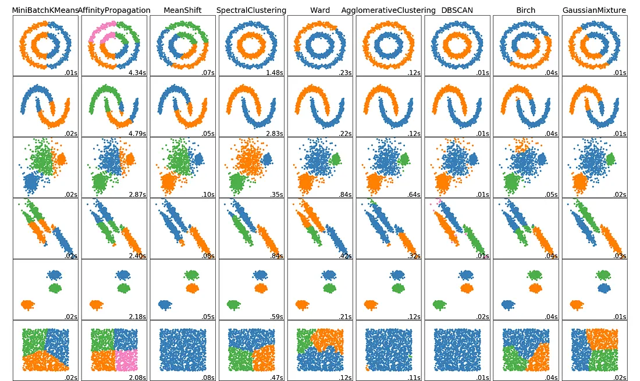
DBSCAN

Slide 15

Use of the topic - Activity with IRIS data set from R studio
IRIS Data Set
150 individual iris flowers
Three distinct species of iris flowers
150 rows (observations) and 5 columns (sepal and petal length and width, and specie)
Activity: Use k-means method to determine specie of each observation

Slide 16
Use of the topic - Activity with IRIS data set from R studio
Load data set in R
data <- iris[, 1:4] #Columns 1 to 4 for not loading the specie column (5)
df <- na.omit(df) #Omit NA values
df_scaled <- scale(df) #Scale data to standardized values
set.seed(123) #Set seed to fix the number of random variables to initialize the k-centroids
km3 <- kmeans(df_scaled, centers = 3, nstart = 25) #3 k-means because the data set has 3 different species
#Visualize clusters
fviz_cluster(
km3,
data = df_scaled,
geom = "point",
ellipse.type = "convex",
main = "K-Means Clustering of Iris Dataset (k = 3)"
)

Slide 17
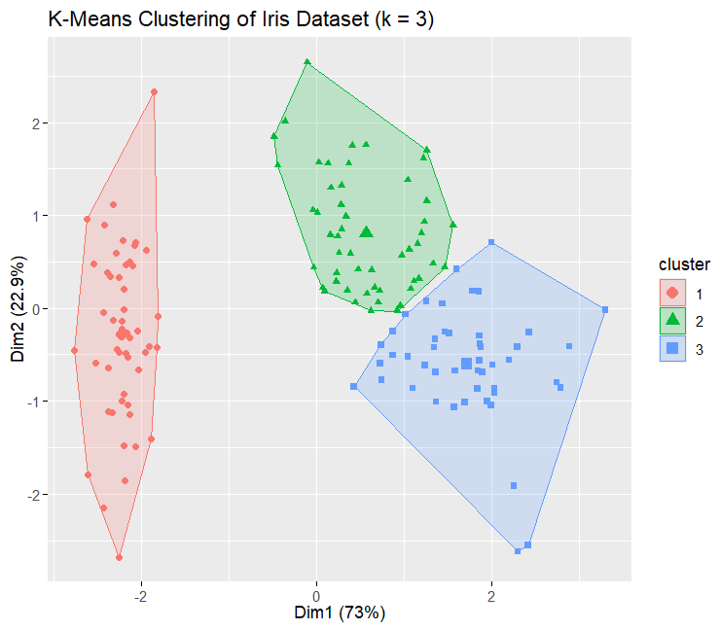
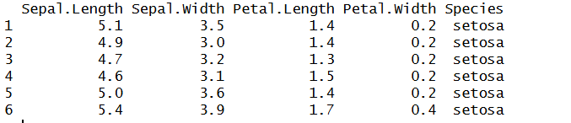
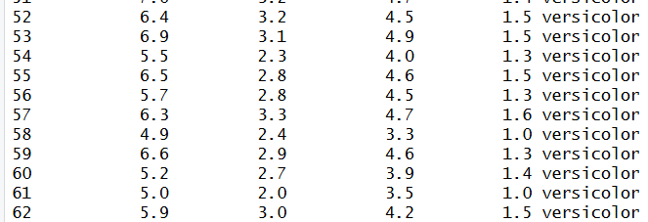
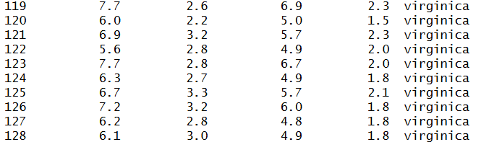
Use of the topic - Activity with IRIS data set from R studio

Slide 18
Use of the topic - Activity with IRIS data set from R studio
#1. Load data
data <- iris[, 1:4] #Columns 1 to 4 for not loading the specie column (5)
df <- na.omit(df) #Omit NA values
scaled_data <- scale(data) #Scale data to standardized values
set.seed(123) #Set seed to fix the number of random variables to initialize the k-centroids
# 2. Calculate distances and build the hierarchy
distance_matrix <- dist(scaled_data, method = "euclidean")
hc <- hclust(distance_matrix, method = "ward.D2")
# 3. Plot the complete Dendrogram
plot(hc,
main = "Hierarchical Clustering: Full Dendrogram",
xlab = "Data Points",
sub = "",
labels = FALSE)

Slide 19
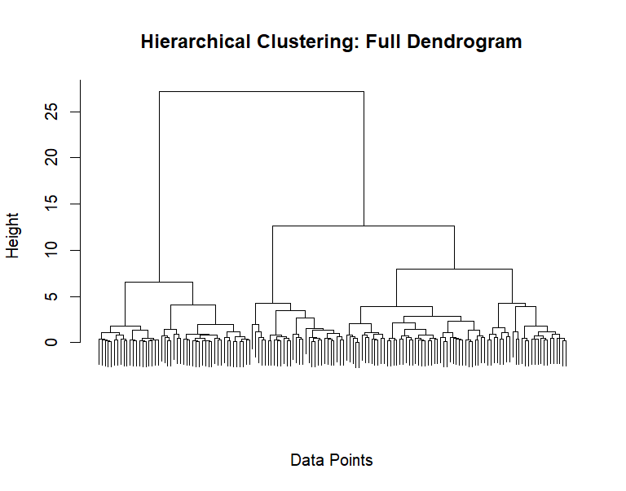
Use of the topic - Activity with IRIS data set from R studio

Slide 20
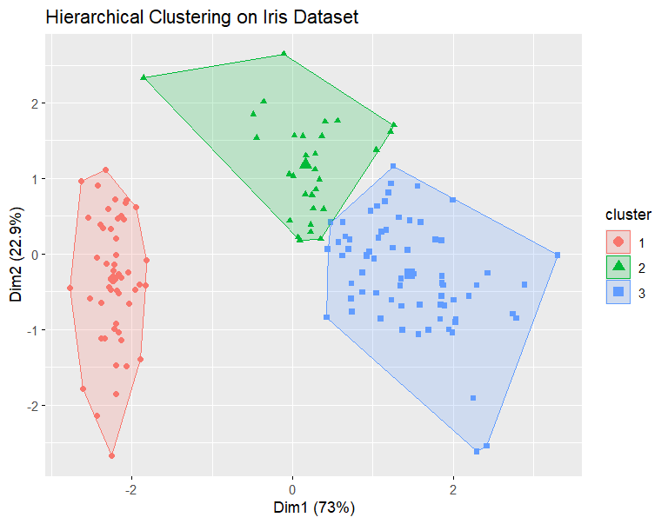
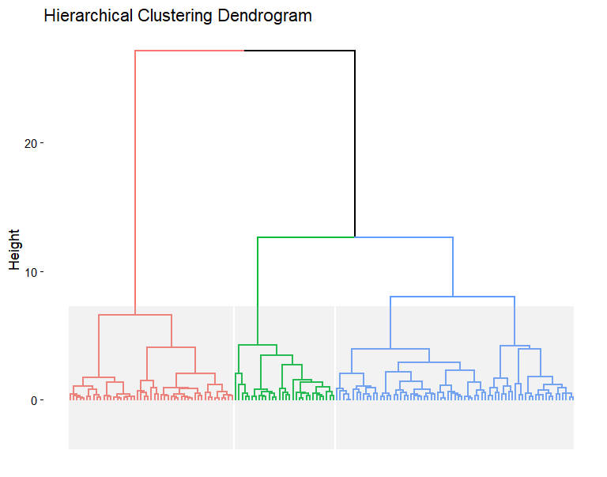
Use of the topic - Activity with IRIS data set from R studio

Slide 21
Use of the topic - Activity with IRIS data set from R studio
Load data set in R
library(dbscan)
library(factoextra)
data <- iris[, 1:4]
scaled_data <- scale(data)
set.seed(123)
db <- dbscan(scaled_data, eps = 0.8, minPts = 5) #DBScan function (note it does not require the number of clusters, as previous methods)
print(db)
fviz_cluster(db, data = scaled_data,
geom = "point",
main = "DBSCAN Clustering on Iris Dataset")

Slide 22
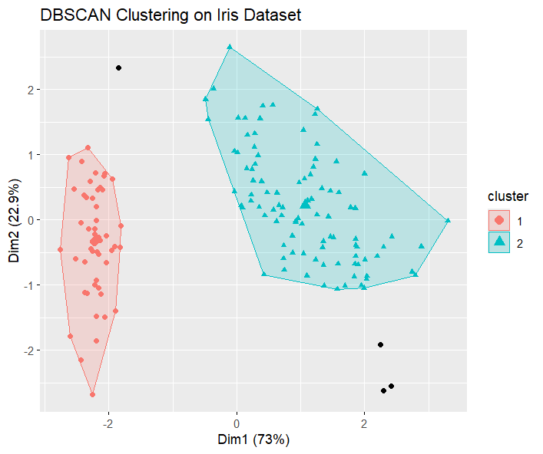
Use of the topic - Activity with IRIS data set from R studio

Slide 23
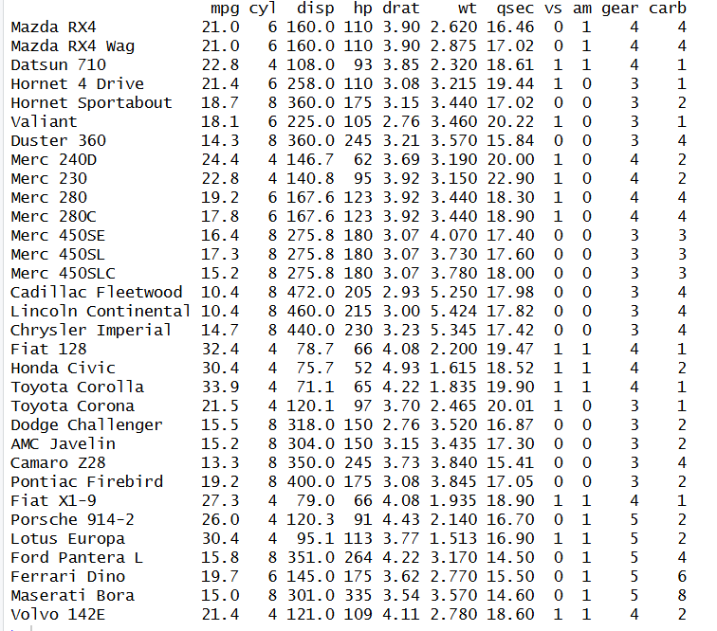
Activity: Replicate three methods with cars data_set
Data set extracted from 1974 Motor Trend US Magazine which describes 10 performance features of 32 vintage automobile models (1973-1974)
Load Data_SET
df <- mtcars
df <- na.omit(df)
df_scaled <- scale(df)
Repeat three methods of clustering with mtcars data_set

Slide 24
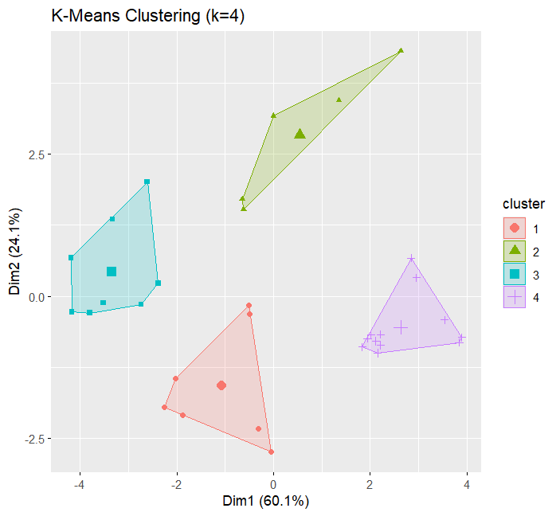
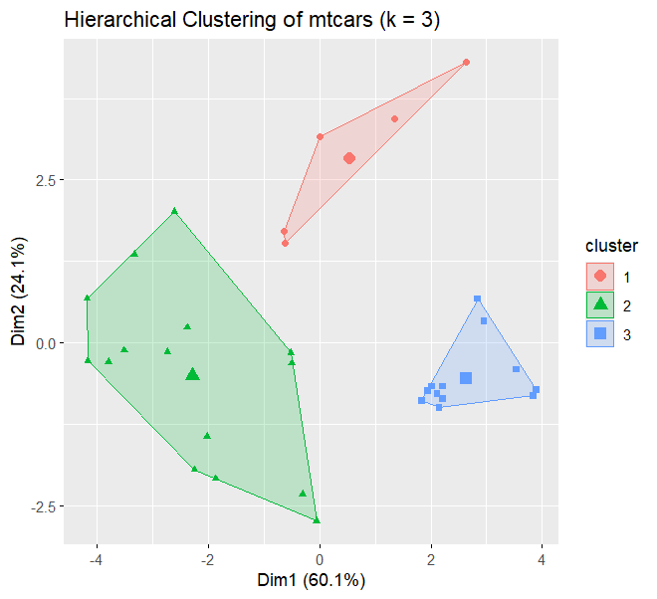
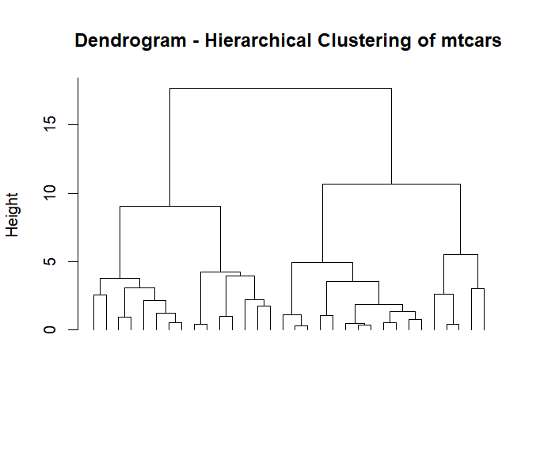
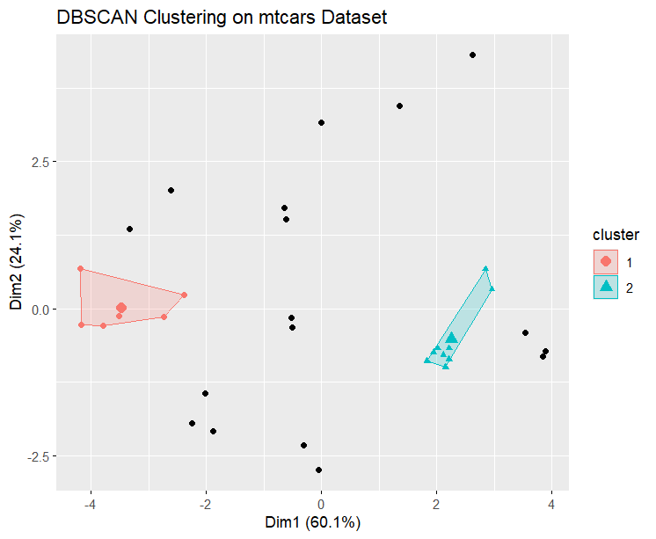
Activity: Replicate three methods with cars data_set

Slide 25
REFERENCES
Han, J., Kamber, M., & Pei, J. (2012). Data mining: Concepts and Techniques, Waltham: Morgan Kaufmann Publishers, 2012-13.
Bioinformatics Crash Course. (2020). Lesson 9: Clustering. Bioinformatics Crash Course 1.0 Documentation. https://www.bioinformaticscrashcourse.com/9.1_Clustering.html#clustering-data

